Slide 1
Domain Driven Design

Slide 2
Principles
Placing primary focus on the core domain and domain logic
Basing complex designs on a model of the domain
Initiating a creative collaboration between technical and domain experts to iteratively refine a conceptual model that addresses domain problems
Notes:
A model that can be understood and interpreted seamlessly between domain expert(s) and developer(s)
Understanding the terms used by the domain experts and developers and trying to have an organized set of terms which can be unambiguously understood by both participants

Slide 3
“The model isn’t just the knowledge in a domain expert's head; it is a rigorously organized and selective abstraction of that.”
- Eric Evans
Notes:
Domain == problem
Model == solution
Can be expressed in several ways:
Code
Diagrams
Written Documentation

Slide 4
Model expressed in software
Entities
Value Objects
Services
Notes:
Entities: Unique identity(string ,integer or any other single attribute ) for an Entity (object)e objects
Value Objects: When only the attributes of an object are important considerations then such an object is classified as a Value Object.
Service: Some concepts from domain are not capable to be modeled as entity or Value objects and hence called Services.

Slide 5
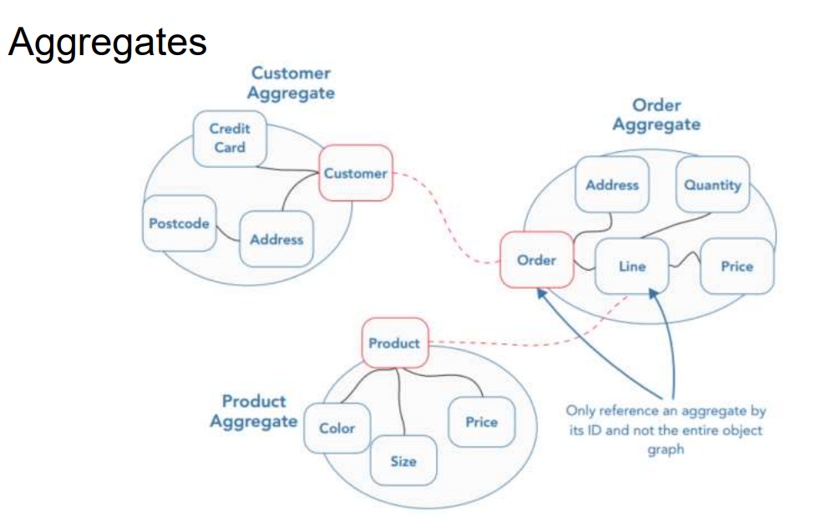
Notes:
An Aggregate is a cluster of Entities and Value objects.

Slide 6
Create Orders
Order more than one items, extra items price takes 10% discount
An order with items total of original price greater than 3000 get High priority, greater than 1000 get normal priority, otherwise Low priority
Delivery fee charge based on item type (not quantity of the item)
High priority charge delivery fee of supplier delivery fee plus 10% * total order price, Normal priority 5%, Normal priority none
Notes:
Demo project

Slide 7
Create Order
Add Item
OrderItemAddedEvent
Apply Order Priority
Calculate Delivery Fee
OrderPriorityChangedEvent

